Slide 1
Computational Perspectives on Workplace Dynamics and Mental Health in the Tech Industry: Insights from a Survey-Based Study

Slide 2
Outline
1. Objective and Background
2. Data Source
3. Exploratory Data Analysis (EDA)
4. Modeling Approach
5. Results and Findings
6. Conclusion and Future Improvement

Slide 3
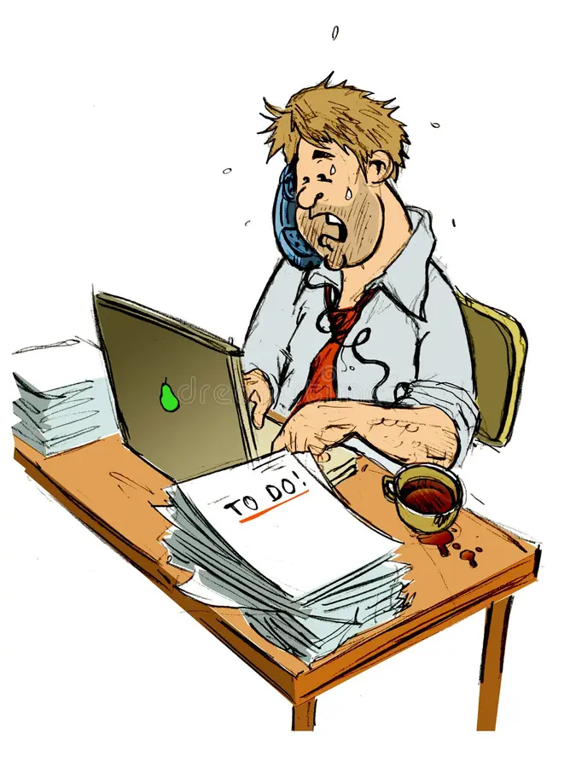
Background
Nearly 970 million people worldwide suffer from mental illness (WHO, 2022)
People with untreated mental illnesses who go to work do so with a physical, mental, and emotional impairment (Goetzel et al., 2018)
Anxiety, depression and substance use disorders are the most common mental health problems among employed adults (Goetzel et al., 2018)
50-60% of adults with mental illness don’t receive treatment and mental health services (Goetzel et al., 2018)
Increased rates of short-term disability, safety incidents, absenteeism, presenteeism (working while sick), underperformance, stress imposed on team members, overtime and overstaffing (Goetzel et al., 2018)
Notes:
The WHO In 2019 estimated that 1 in every 8 people, or 970 million people around the world were living with a mental illness, with anxiety and depressive disorders being the most common
Currently, among employed adults, anxiety, depression and substance use disorders are the most common mental health problems
Unfortunately, between 50 and 60 percent of adults with mental illness do not receive the necessary mental health services, which obviously can lead to major issues like physical, social, and emotional impairments
In addition to the direct costs associated with mental illnesses, there are also many indirect costs, which include increased rates of short-term disability, safety incidents, absenteeism and presenteeism (working while sick), underperformance, stress imposed on team members, overtime and overstaffing to cover sick-day absences, and many more
& this was shown in several studies. For example, in one study it showed that there were more workers absent from work because of stress and anxiety than because of physical illness. and additionally, more days of work loss and work impairment are caused by mental illness than other chronic conditions such as diabetes, asthma, and arthritis.
Moreover, several studies over the years have proven that an alarming number of people live with mental illnesses, of which only a fraction is documented. Studies have also indicated that these figures are much higher in the tech industry.
So this was just a small background into the importance of mental health and that if mental illness doesn't get treated properly, it can lead to many complications which also seep into the workplace affecting not just the individual but people around as well
so its very crucial for companies to lay out mental health resources and policies for their employees that would benefit them in the long run
For this project, I wanted to dive a little deeper into this and examine the impact of different workplace policies on mental health seeking behavior and how these workplace policies, such as the provision of mental health benefits and employee wellness programs, influence the likelihood of individuals seeking treatment for mental health conditions? To identify any potential predictors of mental health illness in the workplace.

Slide 4
Objective
To see if we can use machine learning to predict whether an employee will seek treatment for their mental illness
To understand how work policies and work environment can affect whether a person will seek treatment
General Question: Does the organizational culture of tech companies affect the mental health of employees? What aspects of the organizational culture have the most affect?
Notes:
And a general question that guided me through my research was: ‘ Does the organizational culture of tech companies affect the mental health of employees? What aspects of the organizational culture have the most affect?’

Slide 5

Data Source
OSMI - Open Sourcing Mental Illness
They conduct ongoing surveys that measure attitudes towards mental health among employers and employees in the tech industry, and examine the prevalence of mental health disorders among tech workers
The Open Sourcing Mental Illness team of researchers aim to raise awareness and help improve conditions for those with mental health disorders working in the tech/IT workplace
OSMI Home :: Open Sourcing Mental Health - Changing how we talk about mental health in the tech community - Stronger Than Fear (osmihelp.org)
The OSMI mental health in tech survey
Dataset consisting of survey questions and responses about various aspects of the mental health of tech workers.
Measures attitudes towards mental health and mental health policies in the tech workplace
Notes:
the data I used for this project came from a non-profit organization called Open Sourcing Mental Illness, and it's an organization dedicated to raising awareness, educating, and providing resources to support mental wellness in the tech and open source communities.
And for their research, they conduct ongoing surveys that measure the attitudes towards mental health and the prevalence of mental health disorders among employees in the tech industry
And the data I used was from one of their surveys from 2016

Slide 6
Data
27 variables (not limited to):
Respondents gender, age, country
Family history of mental illness, whether the respondent sought treatment, whether their illness interfered with their work
Respondent’s view towards mental health support in their workplace
Are you provided mental health benefits, mental health stigma in the workplace, etc.
no_employees: How many employees does your company or organization have?
remote_work: Do you work remotely (outside of an office) at least 50% of the time?
benefits: Does your employer provide mental health benefits?
care_options: Do you know the options for mental health care your employer provides?
wellness_program: Has your employer ever discussed mental health as part of an employee wellness program?
seek_help: Does your employer provide resources to learn more about mental health issues and how to seek help?
anonymity: Is your anonymity protected if you choose to take advantage of mental health or substance abuse treatment resources?
leave: How easy is it for you to take medical leave for a mental health condition?
mental_health_consequence: Do you think that discussing a mental health issue with your employer would have negative consequences?
phys_health_consequence: Do you think that discussing a physical health issue with your employer would have negative consequences?
coworkers: Would you be willing to discuss a mental health issue with your coworkers?
supervisor: Would you be willing to discuss a mental health issue with your direct supervisor(s)?
mental_health_interview: Would you bring up a mental health issue with a potential employer in an interview?
phys_health_interview: Would you bring up a physical health issue with a potential employer in an interview?
mental_vs_physical: Do you feel that your employer takes mental health as seriously as physical health?
obs_consequence: Have you heard of or observed negative consequences for coworkers with mental health conditions in your workplace?
Notes:
So now looking at the specific data I used, it was a survey that contained questions related to the employees personal data like their age, gender, country, family history, etc. along with details of their workplace environment such as the company size, benefits that are offered, how easy it is to take leave, how supportive their employer and environment is, etc.

Slide 7
Data Cleaning

Slide 8
Data Cleaning
Gender variable
Problem: many different categories - Some genders were misspelled, worded differently or didn’t make sense:
"Male-ish"
"something kinda male?"
"Mal"
“F”
“Femake”
"Nah"
"All"
“Female (Trans)”
"Enby"
“Woman”
"Fluid"
"Guy (-ish) ^_^"
"male leaning androgynous"
“Cis Man”
"msle"
“Man”
“Cis-female/femme”
"Neuter"
"ostensibly male, unsure what that really means"
"Mail"

Slide 9
Data Cleaning
Age variable
Problem: ages made no sense
3.700e+01 4.400e+01 3.200e+01 3.100e+01 3.300e+01 3.500e+01 3.900e+01
4.200e+01 2.300e+01 2.900e+01 3.600e+01 2.700e+01 4.600e+01 4.100e+01
Dropped ages that seemed to be outliers
Anyone younger than 18 or older than 80
Created an “age_group” variable to see different age ranges
<=19 -> “Teen”
19 - 25 -> “Young Adult”
25 - 65 -> “Adult”
>65 -> “Elderly”

Slide 10
Data Cleaning
Null values
Dropped:
“Comments” column because it had almost 87% null values
“States” column because it was >⅓ null - and wasn't an important variable since we already have the “Countries” column
Replaced the null values in “work_interfere” and “self-employed” with the modes
Lastly, dropped the remaining null values

Slide 11
Data Cleaning
Gender Variable
Age Variable
Null Values
"Male-ish"
"something kinda male?"
“F”
“Femake”
"Nah"
"All"
“Female (Trans)”
"Enby"
“Woman”
"Fluid"
"Guy (-ish) ^_^"
"male leaning androgynous"
“Cis Man”
"msle"
“Man”
“Cis-female/femme”
"Neuter"
"ostensibly male, unsure what that really means"
"Mail"
3.700e+01 4.400e+01 3.200e+01 3.100e+01 3.300e+01 3.500e+01
Dropped:
“Comments” column because it had almost 87% null values
“States” column because it was >⅓ null - and wasn't an important variable since we already have the “Countries” column
Replaced the null values in “work_interfere” and “self-employed” with the modes
Created an “age_group” variable to see different age ranges
<=19 -> “Teen”
19 - 25 -> “Young Adult”
25 - 65 -> “Adult”
>65 -> “Elderly”
Dropped ages that were outliers
Happened to be anyone younger than 18 or older than 80
Notes:
After doing some preliminary analysis, I realized that there’s some issues within a few of the variables,
the first one is the gender variable. As you can see by some of the responses, They were a little all over the place most likely bc they had a text entry option for this question and that is why some genders were misspelled, written differently, or didn’t make sense, so for the sake of ease, I categorized the genders as either female, male, or other.
For the age variable, the ages were encoded in scientific notation so I had to convert them to the right format, then I created an extra variable to see the frequency of different age groups, then I dropped ages that fell outside of the first and third percentiles, which Happened to be anyone younger than 18 or older than 80
Then, I dropped the comments column because it was mostly null, and also dropped the states column because it was redundant, and also dropped the timestamp variable bc it was irrelevant
And then lastly, I replaced the null values in the ‘work_interference’ and ‘self-employed’ columns with their modes

Slide 12
Data Visualization and EDA

Slide 13
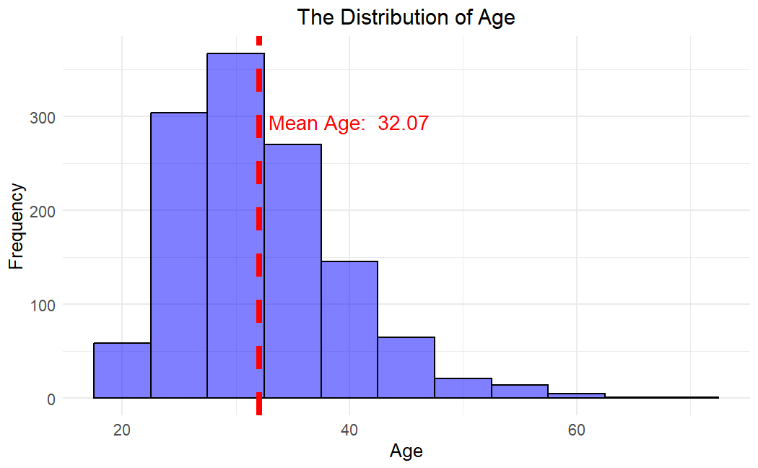
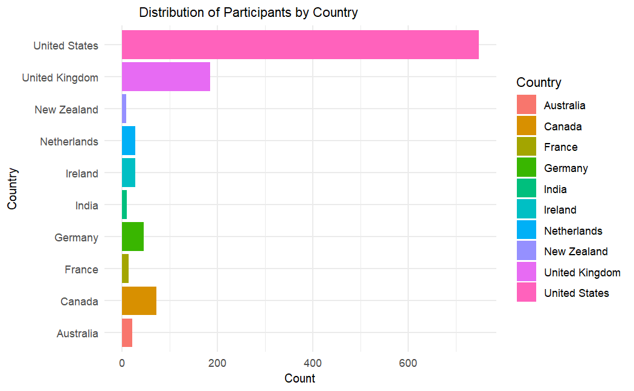
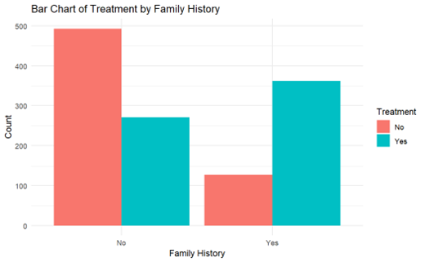
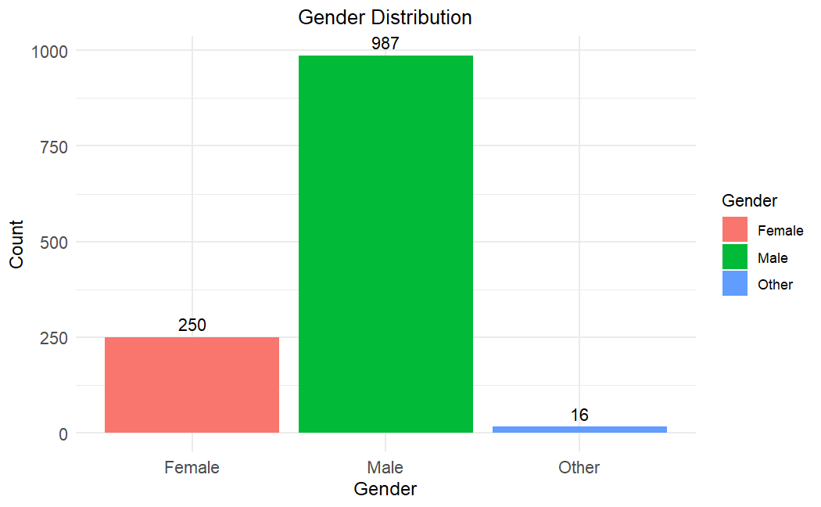
Notes:
These first few visuals i created were just to understand the respondents better
As you can see, the bulk of the respondents were aged from the mid 20s to early 40s having an average age of 32 years
You can also see that the US had the most respondents accounting for nearly 55% of the total respondents,
The plot in the bottom right shows the gender distribution among the respondents,and you can clearly see the stark difference where the majority of the respondents were male
I also looked into whether the respondents sought treatment for their mental health issue based on whether they had a family history of mental illness, and it shows a significant number of them did not seek treatment if they did not have a family history of mental illness whereas people who did have a family history of mental illness more likely sought treatment

Slide 14
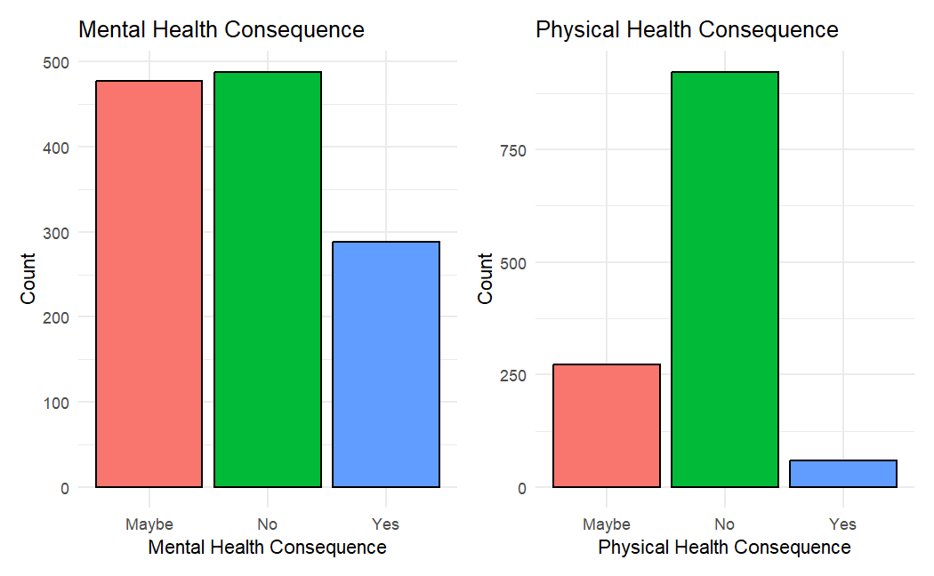
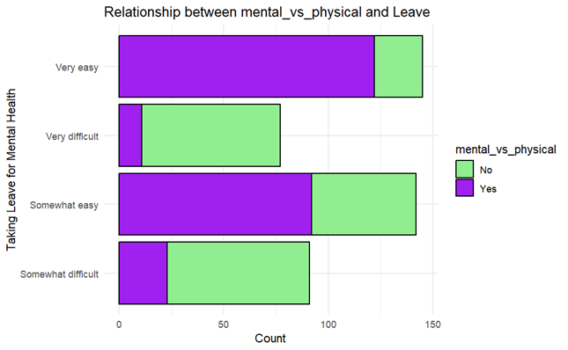
Workplace culture & stigma
Mental illness not taken seriously in the workplace/by employers → discourages employees from talking about their mental health concerns → fear of negative judgements or consequences → increases stress, potentially worsens their conditions
Impact on employee well-being and engagement
Inability to take necessary leave can lead to worsening conditions → implications for productivity, job satisfaction, & employee turnover
Organizations that fail to address such issues might see higher rates of burnout and lower employee engagement rates
Notes:
Ok now moving on to these visuals
There were two variables, mental health consequence (asks if the respondent thinks there will be a negative consequence if they discuss a mental health issue with their employer) and physical health consequence (which asks the same thing but for discussing a physical health issue), so the top chart shows that more respondents said maybe or yes for the mental health consequence compared to the physical health consequence. So basically in other words, significantly less respondents believe that they'll face negative consequences if they discussed their mental health concerns
The plot in the bottom examines the level of ease or difficulty that the respondents find in taking medical leave for a mental health related condition and whether the respondents feel that their employer takes mental health as seriously as physical health. and by looking at that plot, we can see that the respondents find it much easier to take medical leave for a mental health issue when they feel that their employer regards mental health with the same importance as physical health and conversely, they find it difficult to take medical leave when they feel that their employers don't take mental health as seriously as physical health
Mental health issues might be perceived as a sign of weakness or as a less legitimate reason for medical leave compared to physical health issues. This stigma can discourage employees from discussing mental health concerns for fear of negative judgments or consequences. In such environments, employees might fear that their reasons for leave will not be seen as valid, which can increase stress and potentially exacerbate their mental health conditions.
The reluctance to discuss mental health issues or take necessary leave could lead to worsening conditions for affected individuals, which has broader implications for productivity, job satisfaction, and employee turnover in the tech industry. Organizations that fail to address these issues might see higher rates of burnout and lower overall employee engagement.

Slide 15
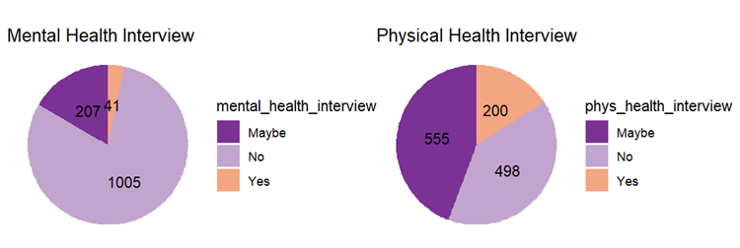
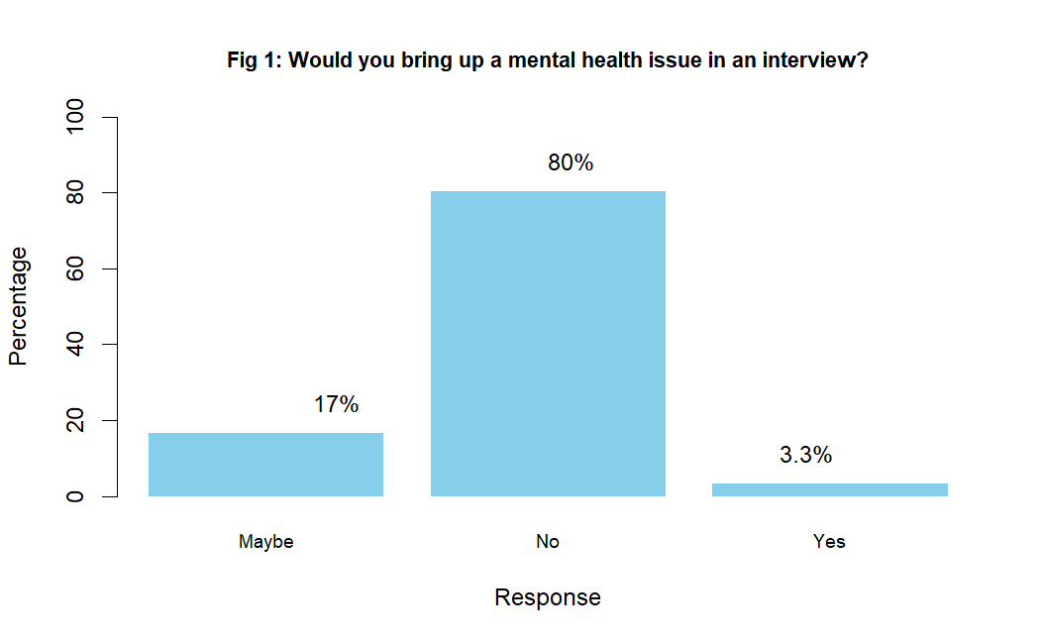
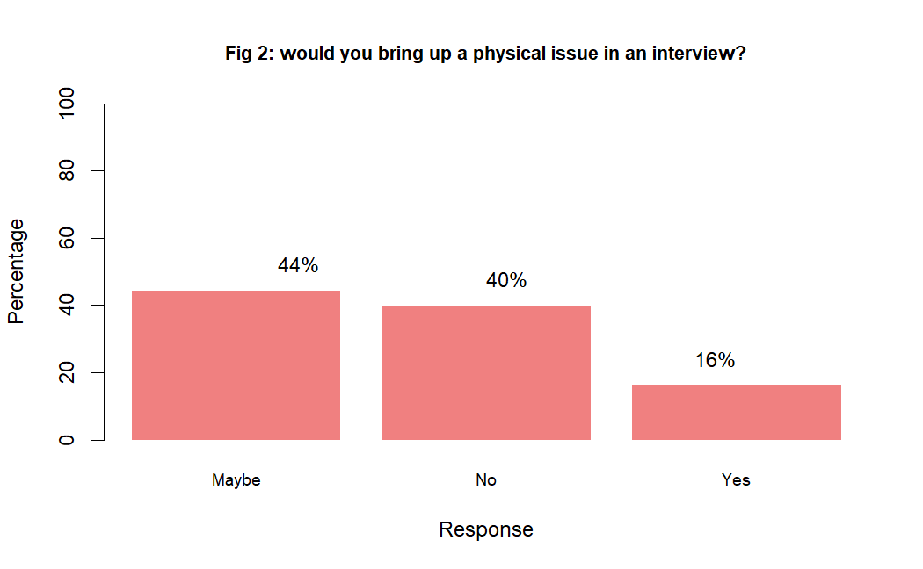
Notes:
The plots on this slide represent how much respondents would be willing to discuss mental health issues compared to physical health issues in their interviews with their employers
These plots collectively show that there is a vast difference in their responses where around 80% of the respondents would feel uncomfortable speaking about a mental health issue in an interview whereas half of them would feel comfortable talking about a physical issue instead
similarly, just about 3.3% of employers would feel comfortable discussing their mental health history, compared to 16% for physical health
This perhaps shows that there is a stigma towards discussing mental health related issues compared to physical health issues

Slide 16
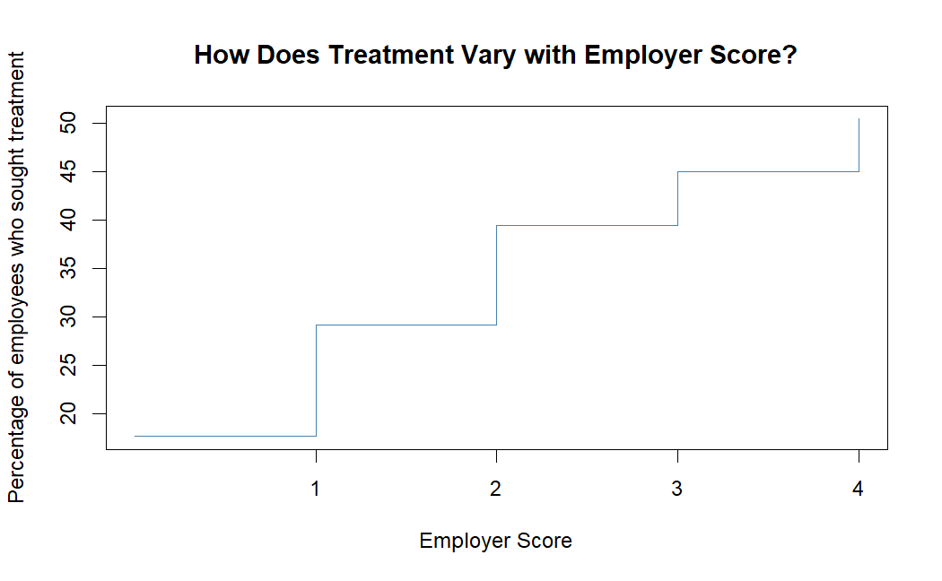
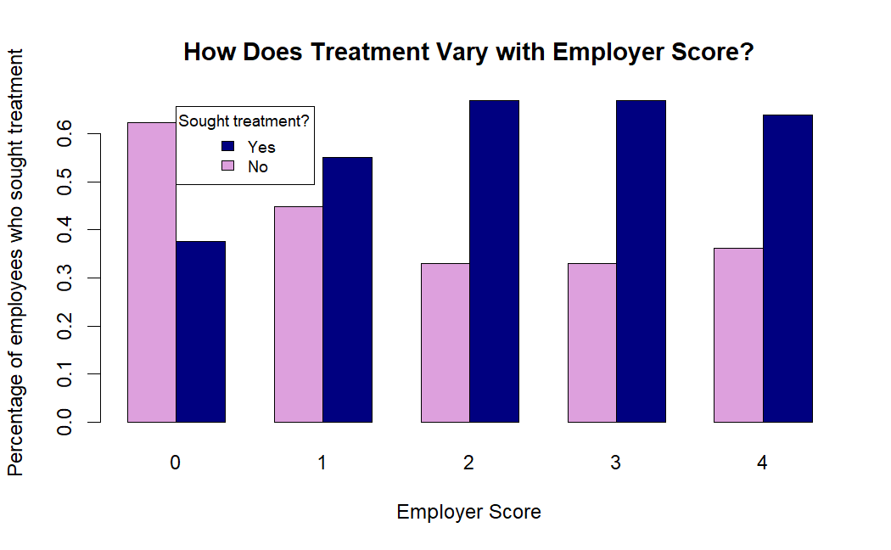
Based on four variables:
Benefits, Care Options, Seek Help, and Wellness Program
As the employer score increases, the number of treatments sought by employees also increases. The top plot shows that the biggest jump for treatment is when employer score goes from 0 to 1 → if employer offers at least one benefit, it can encourage a much higher number of employees to seek necessary treatment
Notes:
For these plots, i created a variable called employer scores which is based on 4 variables:
Benefits: which asked if the employer provides mental health benefits?
Care Options: which asked the respondent if they know the options for mental health care that their employer provides?
Seek Help: which asked if the employer provided resources to learn more about mental health issues and how to seek help?
Wellness Program: which asked if the employer ever discussed mental health as part of an employee wellness program?
For every "Yes" response from these questions, I incremented the employer score by 1.
These plots show the higher the employer score was, (meaning the more benefits, resources and options they offered), the number of treatments sought by employees increased. And this indicates that Employees are therefore more motivated to seek treatment when employers become more open about mental health and provide proper policies including access to mental health related resources and wellness initiatives. The graph at the top right also shows that the biggest jump for treatment is when employer score goes from 0 to 1, and this indicates that If an employer offers atleast one benefit, it can encourage a much higher number of employees to seek necessary treatment.

Slide 17
Model Selection

Slide 18


Selecting Target Feature and Predictors
Target Feature:
Treatment
Have you sought treatment for your mental health condition?
Predictors:
All other variables
Age, gender, family history, views towards mental health support in the workplace, ect.
Notes:
In this presentation, I’ll only focus on two models, the RF model and KNN model. And again, the target feature is the treatment variable which asked if the respondent sought treatment for their mental health condition, and the predictors were all the other variables. And obviously I encoded the categorical variables as numeric variables and I split the data into training and testing sets: 80% training and 20% testing

Slide 19
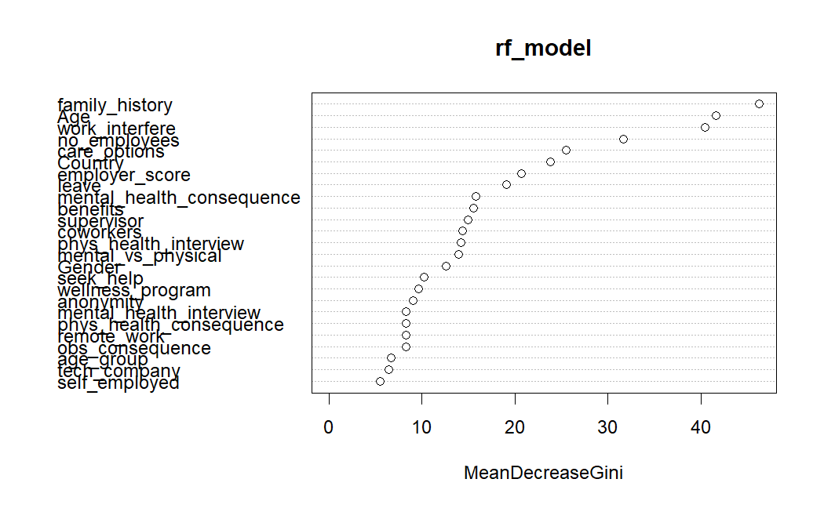
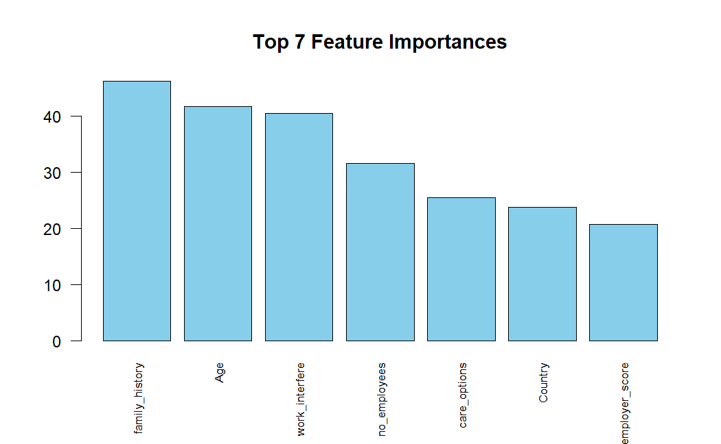
Random Forest
Precision: 0.749
Recall: 0.754
F1 Score: 0.751
ROC-AUC: 0.7064516
Type of random forest: classification
Number of trees: 500
No. of variables tried at each split: 5
OOB estimate of error rate: 25.43%
Confusion matrix:
No Yes class.error
No 317 113 0.2627907
Yes 110 337 0.2460850
Notes:
So as you can see, in this random forest model, 500 decision trees were created in the ensemble and 5 variables were chosen at each split
The out of bag error for this model came out to be 25.43% meaning thats how much times the model will make mistakes when predicting, that also means that the random forest is accurate 74.57% of the time
The confusion matrix also provides similar information to that as well - so for individuals that the model predicted they would not seek treatment and they in fact didnt, the model was accurate 74% of the time - and for the individuals that the model predicted would seek treatment and they did actually seek treatment the model was accurate 75% of the time
So although theres room for improvement, the RF model did a pretty decent job
Along with the RF model, I printed out the 7 top importances which are basically the top 7 features that helped the trees the most in making their decisions, and just looking at the top 3, its family history, age and work interference.
The plot in the top right shows the same information as the bar chart, so as you go down, the variables become less influential in the modeling for the random forest

Slide 20
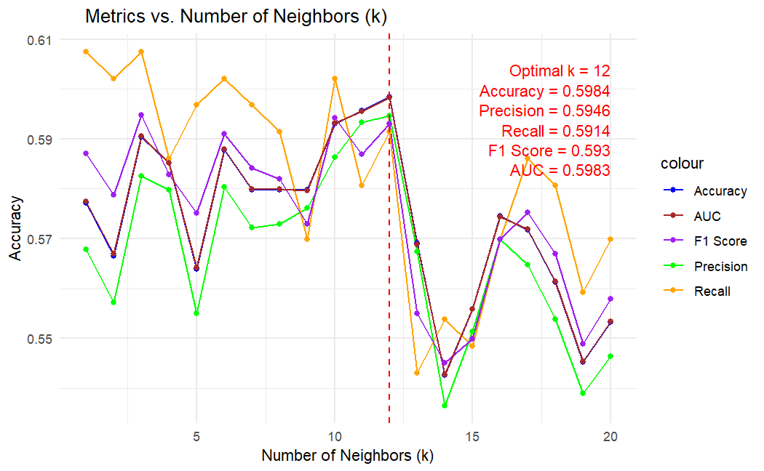
K-Nearest Neighbors
Precision for KNN: 0.59464
Recall for KNN: 0.59143
F1 Score for KNN: 0.59334
ROC-AUC for KNN: 0.59835
Powerful algorithm used in pattern recognition, stores all available cases and classifies new cases based on similarity measure (ex: distance measure)
Potential reasons for low scores:
Complexity of mental health factors
Confounding factors
High dimensionality
Enhancing Model Performance:
Dimensionality reduction
Feature selection and engineering
Addressing data imbalance
Model optimization
Notes:
Ok so now moving on to KNN, as you know, KNN is powerful in pattern recognition, however unfortunately, it did not perform as well as I had expected, as you can tell by the scores
Some possible reasons for that is due to
the complexity of mental health factors, bc Mental health is influenced by many different factors, which might not be fully captured by the predictors.
There is also Unobserved or unmeasured confounding variables, such as stress or personal life circumstances, which could have introduced noise, impacting model accuracy.
And also because of high dimensionality, This dataset included numerous predictors, possibly leading to what is known as the ‘curse of dimensionality’, where distances between points become less meaningful, which impacts the model performance.
Some possible ways to improve this models performance is:
To reduce dimensionality by using techniques such as PCA
To also perform feature selection and engineering, Prioritizing features that have a stronger impact on mental health behaviors and possibly consider creating new features that capture more nuanced relationships.
Also using resampling techniques like oversampling or undersampling to balance the distribution of classes in the dataset
And lastly, experimenting with different distance metrics, K-values, and preprocessing techniques to optimize model performance.

Slide 21
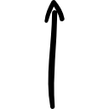


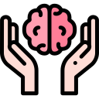
Key Findings
Family history of mental health
Care Options
Work interference
Company Size
Provisions of mental health benefits from employers
Strong Predictors
Mental vs Physical Health
Employees/employers differentiated between the way they dealt with mental and physical health issues
Openness
Employees felt insecure about opening up about their mental health issues with others in their workplace
Small vs Big Companies
Larger companies were more likely to provide more resources and introduce mental health benefits as part of wellness programs, but they did not necessarily do better at informing their employees about care options
Anonymity and Workplace Culture
Concerns about anonymity and observed negative consequences affect whether employees are willing to discuss mental health issues or seek help
Notes:
Moving on to key findings, these were some of the main findings that I was able to fit into one slide…
Based on some of the analyses, my random forest and logistic regression models, some of the strongest predictors came out to be the family history of mental health, whether there are care options available, the company size, whether the mental illness interfered with their work, and the provision of mental health benefits
Another insight was related to the stigma associated with mental health such that employees felt more comfortable discussing physical health issues with their employers and supervisors than mental health issues and similarly, employees found it easier to take medical leave for mental health when they perceived that their employer treats mental health as seriously as physical health.
Another insight was that concerns about anonymity and observed negative consequences affected whether employees were willing to discuss mental health issues or seek help
And a last one was that Awareness of and access to mental health care options correlated with a greater likelihood of employees seeking treatment.
So all in all, these findings point to a need for better policies and practices that equate mental and physical health. Employers who actively work to destigmatize mental health issues and provide robust support systems may not only improve individual employee health outcomes but also enhance team morale and overall productivity. There’s also a need for better communication about the mental health benefits available and possibly for the expansion of those benefits and Strengthening confidentiality protections and creating a more supportive culture could also encourage more employees to seek help when needed.

Slide 22
Challenges, Limitations, and Future Work
Challenges and Limitations
Demographic bias
US dominant
Gender bias
Male dominant
Only about 1260 responses
Data from 2016
Future Work
Look into data from different industries such as healthcare, entertainment, transportation, etc.
Look into data from recent years and compare how policies and the work environments changed throughout the years
Gather more data from different sources for a more in depth study
Consider confounding variables such as stress, anxiety, support systems, health issues, etc.
Experiment with other ensemble methods and boosting
Further analysis on comments using NLP techniques
Notes:
Obviously since the dataset has several limitations and biases, it is not a representative sample for the entire tech-workplace population
One of it’s biases is the demographic bias, nearly 55% of the respondents came from the US whereas the rest came from many different countries
There was also a gender bias, the majority of the respondents were male
Another limitation was the small sample size of only 1260 responses, and the data was a little old as it was from 2016
So for future work, I would like to look into…
Data from different industries such as health care, entertainment, transportation, etc and see how they compare in terms of their work policies and work environments regarding mental health
I would also look into more recent data to get more insight into how attitudes and policies regarding mental health in the workplace have changed over the years
Within future data, I would like to take into account confounding variables such as personal stress levels, anxiety, other health issues and any other variables that may have an impact on a person’s mental health and treatment seeking behavior
I’ll also try experimenting with other ensemble methods and possibly try boosting algorithms like CATBoost and gradient boosting
And lastly I can use NLP techniques to analyse comments to possibly extract meaningful patterns which can give more insights into employee perceptions and experiences related to mental health in the workplace

Slide 23
References
Goetzel, R. Z., Roemer, E. C., Holingue, C., Fallin, M. D., McCleary, K., Eaton, W., Agnew, J., Azocar, F., Ballard, D., Bartlett, J., Braga, M., Conway, H., Crighton, K. A., Frank, R., Jinnett, K., Keller-Greene, D., Rauch, S. M., Safeer, R., Saporito, D., … Mattingly, C. R. (2018). Mental health in the Workplace. Journal of Occupational &amp; Environmental Medicine, 60(4), 322–330. https://doi.org/10.1097/jom.0000000000001271
Mental disorders (who.int)

Slide 24

Thank you :)

